Slide 1
Arduino Music Sequencer
Jenna deBoisblanc
November 3rd, 2014

Slide 2
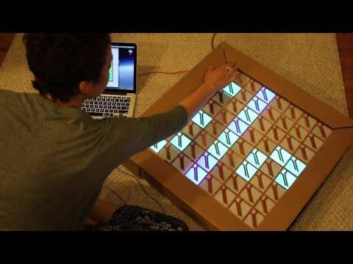

Slide 3
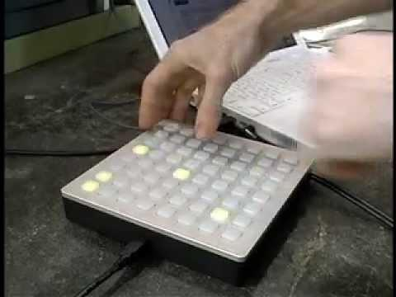

Slide 4
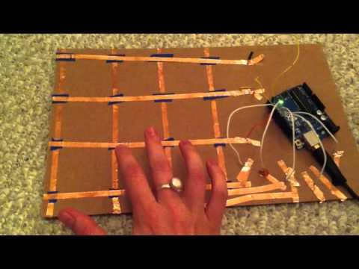

Slide 5
physical computing

Slide 6
use programming to interact with
the physical world

Slide 7
Overview
What is an Arduino?
Writing voltages
Blink
Fade
RGB LEDs
Reading voltages
photoresistor
vibration sensor
button
Neopixels
Neopixels + Processing
Monome

Slide 8
What is Arduino?

Slide 9
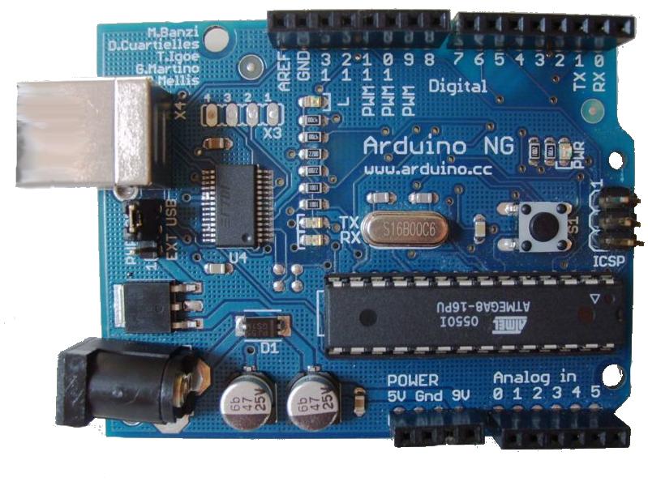
What is Arduino?
open-source hardware+software tool for building interactive electronics projects

Slide 10
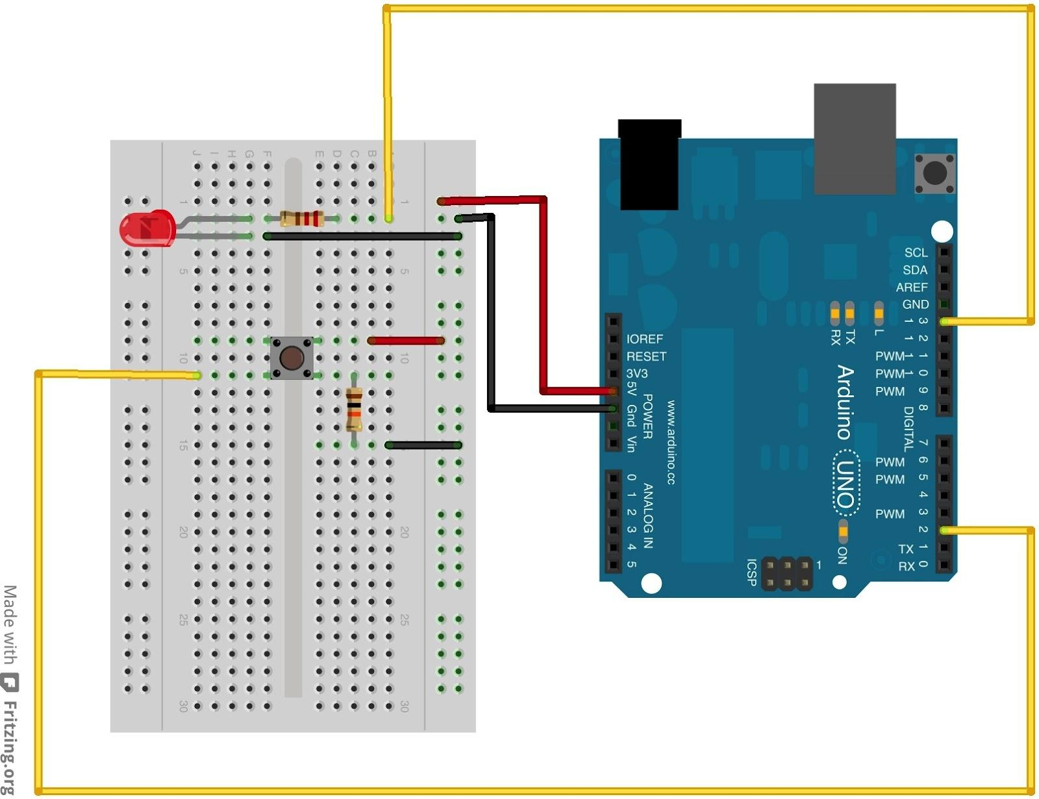
What can an Arduino do?
- write voltages (control components)
- read voltages
(sense the world)

Slide 11

Examples: Solar Sinter

Slide 12
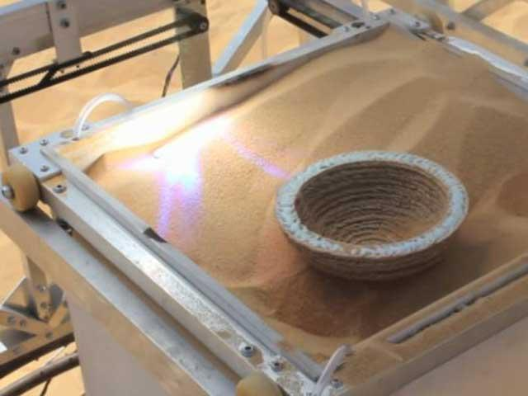
Examples: Solar Sinter

Slide 13
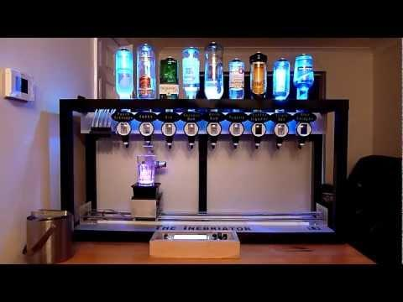
Examples: Cocktail Maker

Slide 14
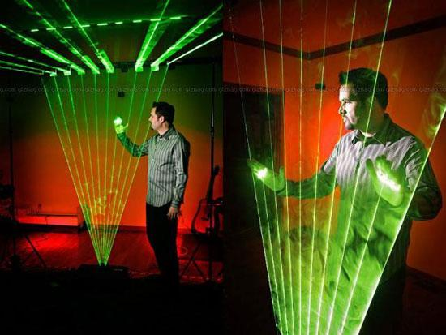

Slide 15

Examples: pimpMyBike

Slide 16
Included in the Arduino kit:
Arduino Uno
USB A to B cable
Miniature breadboard
Male to Male jumper wires - These are high quality wires that allow you to connect the female headers on the Arduino to the components and breadboard. 40 4" wires, 10 6", and 10 9" wires.
2 Tri-Color LEDs
2 Red LEDs - Light emitting diodes make great general indicators.
2 Green LEDs - Light emitting diodes make great general indicators.
2 Blue LEDs - Light emitting diodes make great general indicators.
2 buttons - To interface with outside world
2 Photocell - A sensor to detect ambient light. Perfect for detecting when a drawer is opened or when night-time approaches.
2 Thermistor - A sensor for detecting ambient temperature and temperature changes. 10K thermistor with a negative temperature coefficient.
1 piezo vibration sensor: Minisense 100.
2 Potentiometer: 2 adjustable 10K ohm potentiometer can be used to do ADC input experiments.
1K Ohm Resistors - 5 current limiting resistors for LEDs, and strong pull-up resistors.
5K Ohm Resistors - 5 current limiting resistors for LEDs, and strong pull-up resistors.
A buzzer

Slide 17
Simple Circuit

Slide 18
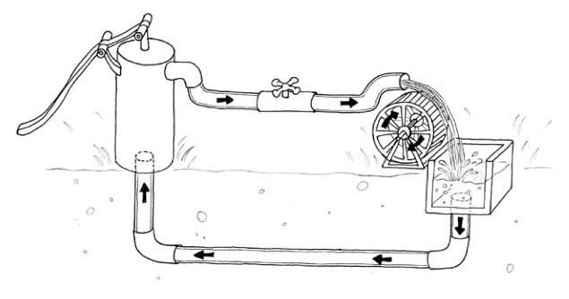
circuit water analogy
Resistance
(R)
Voltage
(V)
<- Current (I)

Slide 19
resistor calculator
What value are the resistors?
http://www.digikey.com/en/resources/conversion-calculators/conversion-calculator-resistor-color-code-4-band

Slide 20
Writing
(output: making things move, light up, beep, etc.)

Slide 21
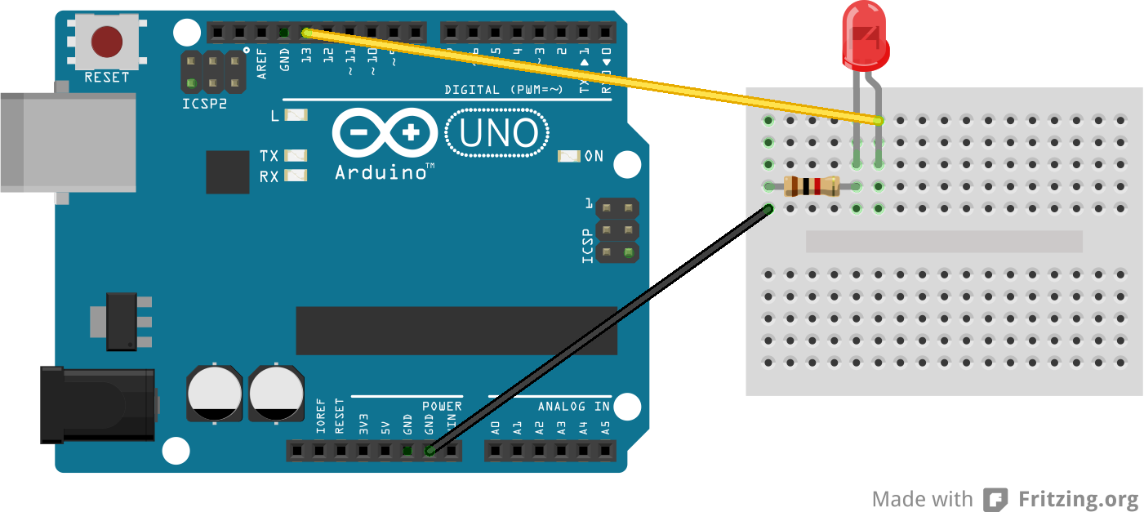
e1: Blink Circuit
use 1K resistor

Slide 22
e1: Blink Sketch
can you make the LED blink faster?
slower?

Slide 23
Writing Functions
digitalWrite(pin, value)
where value is HIGH or LOW
use any pins
analogWrite(pin, value)
where value is 0-255
use digital pins with the ~ (PWM)

Slide 24
Blinking ½ as bright
What do we need to change about the original Blink circuit to make the LED blink half as bright?
(hint: 2 changes)

Slide 25
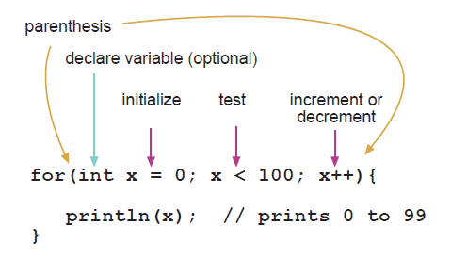
e2: Fading
“for loops”
http://arduino.cc/en/Reference/For

Slide 26
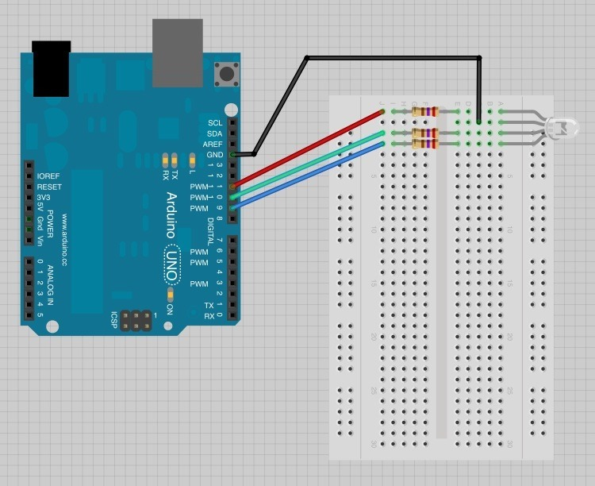
e3: RGB LED
The long leg is the
“cathode” and it’s
connected to
ground.
use 1K resistors

Slide 27
e3: RGB LED
change the R,G,B values to mix colors!
http://www.colorpicker.com/

Slide 28
Reading
(input: reading sensors: light, sound, temperature, ...)

Slide 29
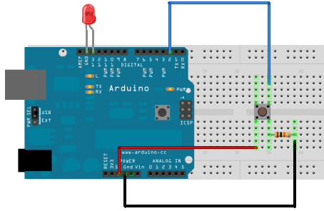
e4: Button Circuit
use 5K resistor

Slide 30
e4: Button Sketch
What function reads the value of the button pin?

Slide 31
Reading Functions
digitalRead(pin)
returns HIGH or LOW
use any pins
analogRead(pin)
returns a value 0-1023
use Analog Input pins

Slide 32
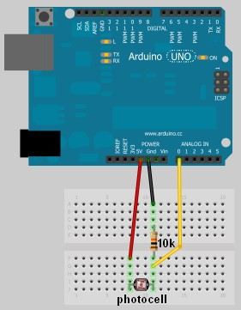
e5: Photoresistor
use 5K resistor

Slide 33
e5: Photoresistor
// define a pin for Photoresistor
int lightPin = 0; void setup() {
// Begin serial communication Serial.begin(9600); } void loop() {
// Write the value of the photoresistor to the serial monitor.
int reading = analogRead(lightPin); Serial.println(reading); }

Slide 34
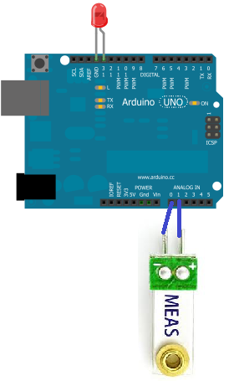
e6: Vibration Sensor

Slide 35
e6: Vibration Sensor
int GroundPin= 0;
int sensePin= 1;
void setup() {
Serial.begin(9600);
pinMode(GroundPin, OUTPUT);
digitalWrite(GroundPin, LOW);
}
void loop() {
int reading = analogRead(sensePin);
Serial.println(reading);
}

Slide 36
e6: Vibration Sensor
Can we make an LED light up when the vibration sensor value is >500?
(hint: check out the button sketch)

Slide 37
e7: Capacitive Sensors
plug an LED into pin 13
plug a jumper into digital pin 2
NOTE: This is an example of writing a user-defined function that’s called in the loop.

Slide 38
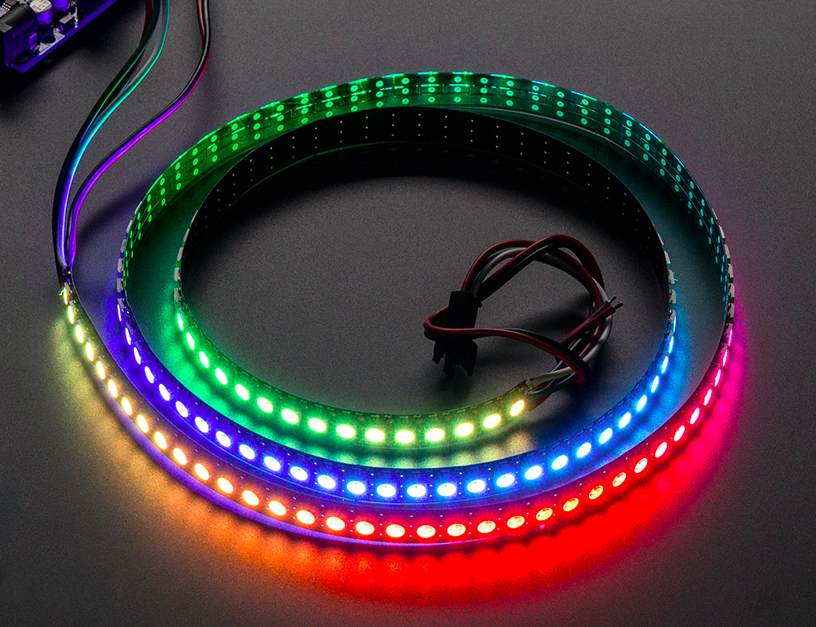
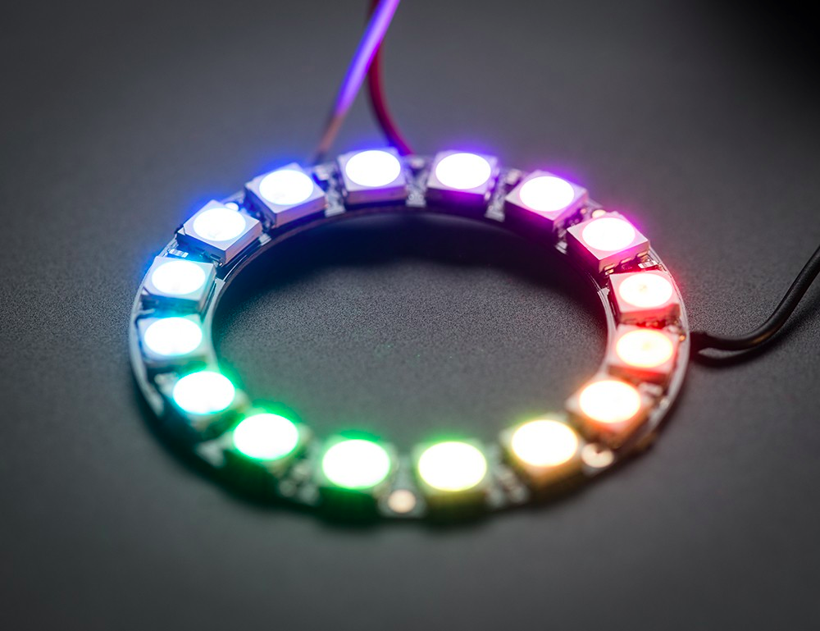
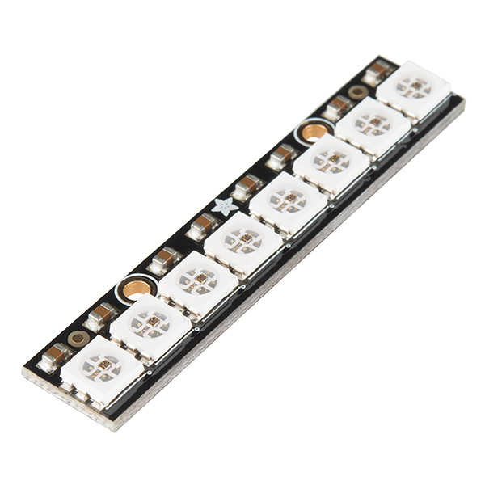
Neopixels

Slide 39
Neopixels
What is a Neopixel?
What is a library?

Slide 40
Neopixel Library
Install Neopixel library & follow instructions
Move Adafruit_Neopixel to your libraries folder:
(home) > Documents > Arduino > Libraries

Slide 41
Strandtest
File > Examples > Adafruit_Neopixel > strandtest

Slide 42
e8: Neopixels
#include <Adafruit_NeoPixel.h>
#define PIN 2
Adafruit_NeoPixel strip = Adafruit_NeoPixel(5, PIN, NEO_GRB + NEO_KHZ800);
void setup() {
strip.begin();
strip.show();
}
void loop() {
//functions go here
strip.setPixelColor(0, 255, 0, 0);
strip.show();
}

Slide 43
Useful Neopixel Functions
strip.begin()
call once in the setup
strip.show()
call everytime you want to refresh LEDs after pin colors have been set
strip.setPixelColor(pinNumber, redValue, greenValue, blueValue)
color values are 0 to 255
strip.setBrightness(brightnessValue)
brightness is between 0 (off) and 255 (brightest)

Slide 44
Neopixel Challenges
Make all of the LEDs Red
Make all of the LEDs Blue
Make the LEDs blink

Slide 45
Processing

Slide 46
Visual Programming Language
Check out the example files!
file > examples

Slide 47
e9: Processing -> Arduino
Let’s make an LED blink when we click the screen.
e6_Processing2Arduino
> e6_ArduinoLED uploaded on Arduino
> e6_Processing opened in Processing

Slide 48
e10: Arduino -> Processing
Let’s send “Hello World from the Arduino to Processing and print it out on the screen.
e7_Arduino2Processing
> e7_Arduino uploaded to the Arduino
> e7_Processing opening in Processing

Slide 49
Monome

Slide 50
The Copper Tape Grid
Lay 4 columns of copper tape (or however many columns you'd like to use; make sure to adjust the code accordingly)
Lay clear tape over the columns everywhere that the columns will intersect with rows (rows and columns need to be electrically isolated)
Attach a jumper to each row and each column of copper tape (I just used copper tape to make the connection) and to the Arduino
Stick an LED in pin #13 on the Arduino.

Slide 51
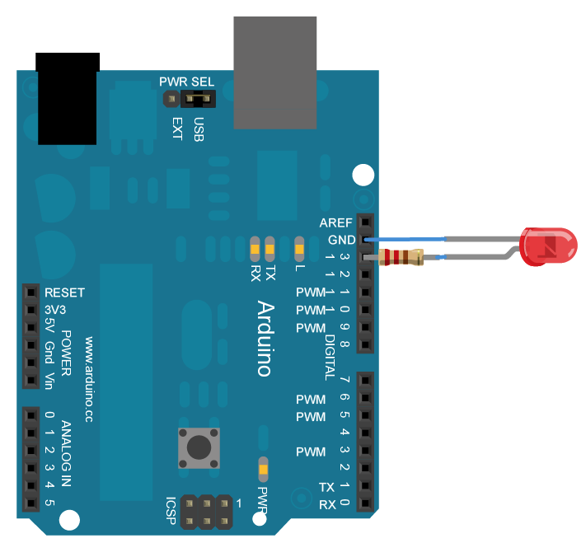

Slide 52
Code
open the Processing sketch:
monome > Processing_monome > Processing_monome.pde
upload the Arduino sketch:
monome > Arduino_monome > Arduino_monome.ino

Slide 53
Reference to Print
http://tinyurl.com/arduinoRef

